Slide 1
Wizard Wreck

Slide 2
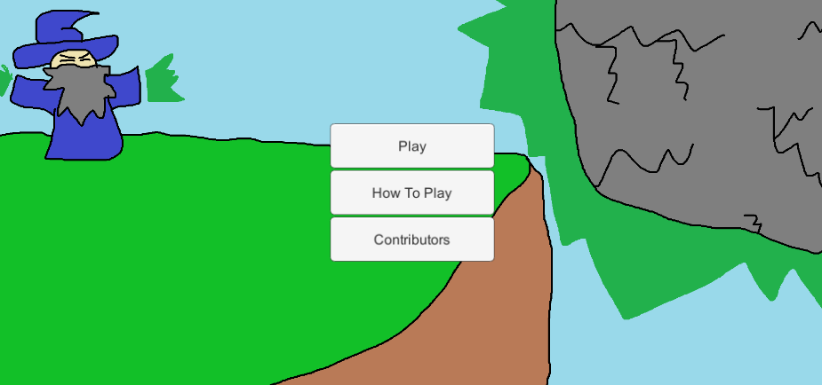
Basics
Small upgrade style game (think Learn To Fly)
The player constantly upgrades the rock in order reach further max distances
Various goblins try to stop the rock’s progression

Slide 3
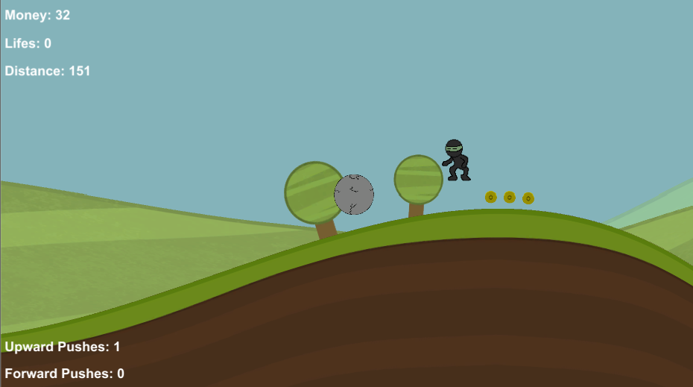
The Game
The player plays a bolder controlled by the wizard
Using forward and upward force pushes the player controls the bolder
The coins are then used to purchase upgrades after the ball runs out of momentum triggering the end of the game

Slide 4
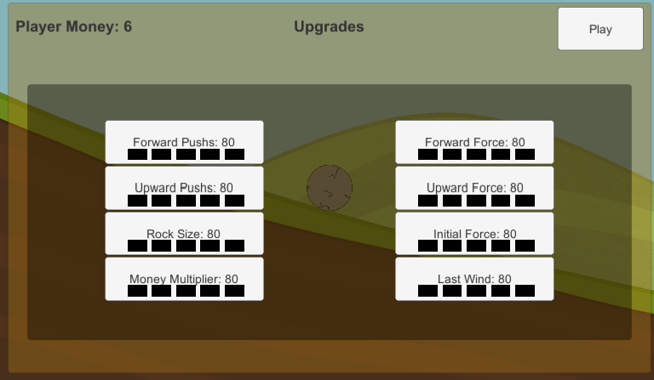
Upgrades
Each level of forward and upward pushes increase the total amount of pushes the player has
The force upgrade for each increase the amount of force applied to the bolder when each push is used
The initial force controls how much force the bolder starts the game with
Last wind corresponds essentially to lifes, instead of the game ending the ball will be pushed forward again

Slide 5
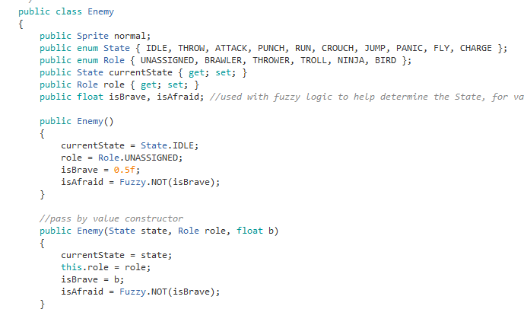
AI
State machine implementation
Uses Roles and States
Roles are assigned to each goblin then used to determine which states can be chosen
States:
Idle
Attack
Run
Crouch
Jump
Panic

Slide 6

Goblin Types: Troll
Scared basic troll
Will always run away or freeze up when the player gets close

Slide 7

Goblin Types: Ninja
Can crouch and jump to dodge the player based off of the rock’s y value
Has a small chance to panic and run away from the rock

Slide 8

Goblin Types: Bruiser
Will usually try to attack the rock to slow it down
Has a small chance of panicking and running away from the player

Slide 9

Goblin Types: Bird
Simple background enemies
Will attack the rock harmlessly if attacked
The player can kill them by getting high enough into the air

Slide 10
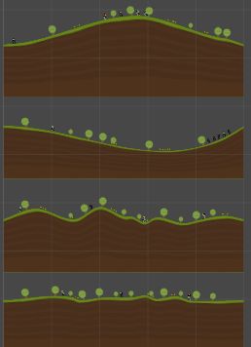
Zippy Terrain
Generation framework
Allows the creation of landmasses based off of a curve
These landmasses could then be randomly selected and placed into the game world
This set up allowed the ball to roll endlessly while also allowing for varied landscapes

